Slide 1

NBA Game Prediction Model
Aydın Köfteci

Slide 2
Purpose of Model
Predict Winner

Slide 3
Project Flow
Loading DataSets and Understanding
1
Exploratory Data Analysis
2
Feature Engineering
3
Building Models
4
Metrics about Model Performance
5

Slide 4
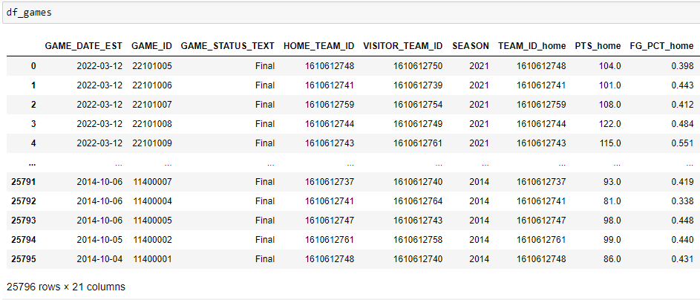
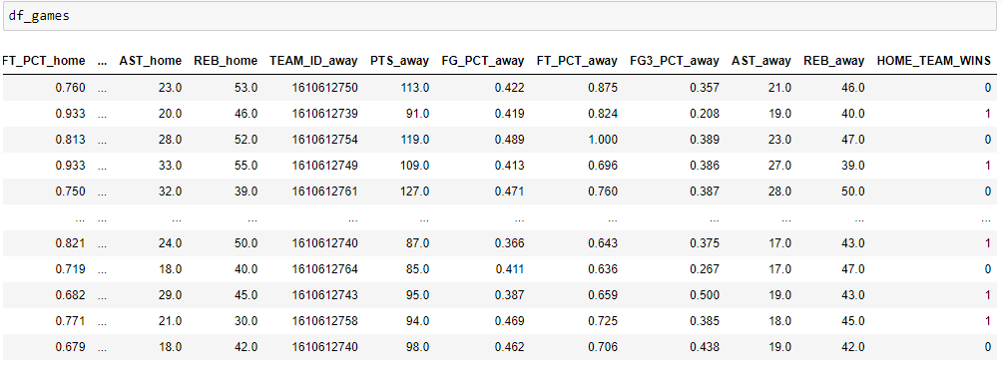
NBA Games data
1
Dataset with all NBA games from 2004 season to dec 2020
Over 25000 games
30 Nba Team
Loading DataSets and Understanding

Slide 5
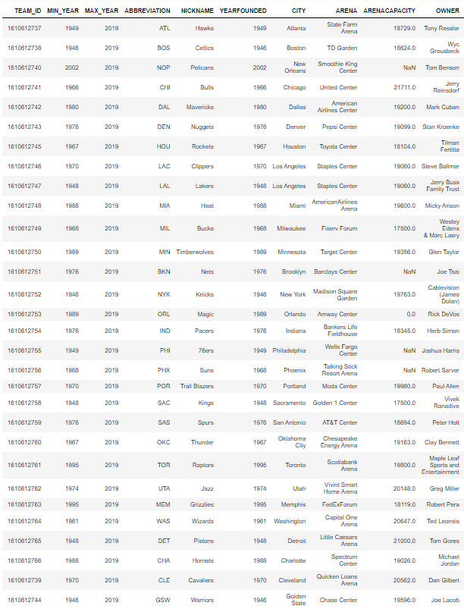
NBA Team Data
1
Loading DataSets and Understanding

Slide 6
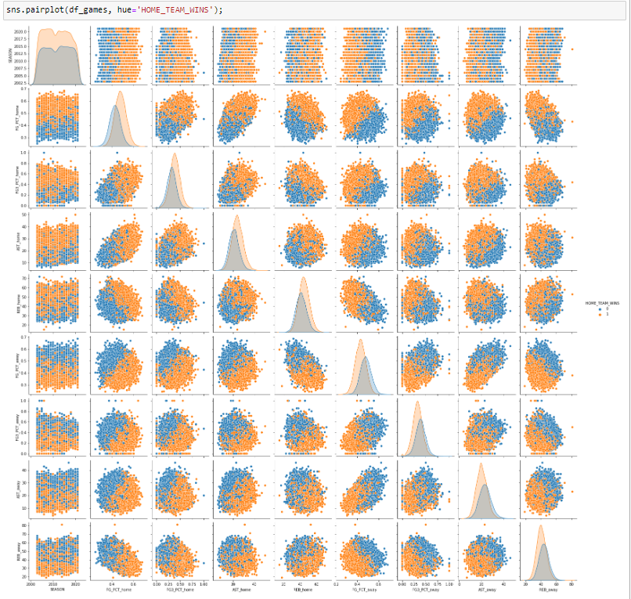
PairPlot
Home Teams are favorable
FieldGoal Percentage
3ptFieldGoal Percentage
Rebound
Assist,
2
Exploratory Data Analysis

Slide 7
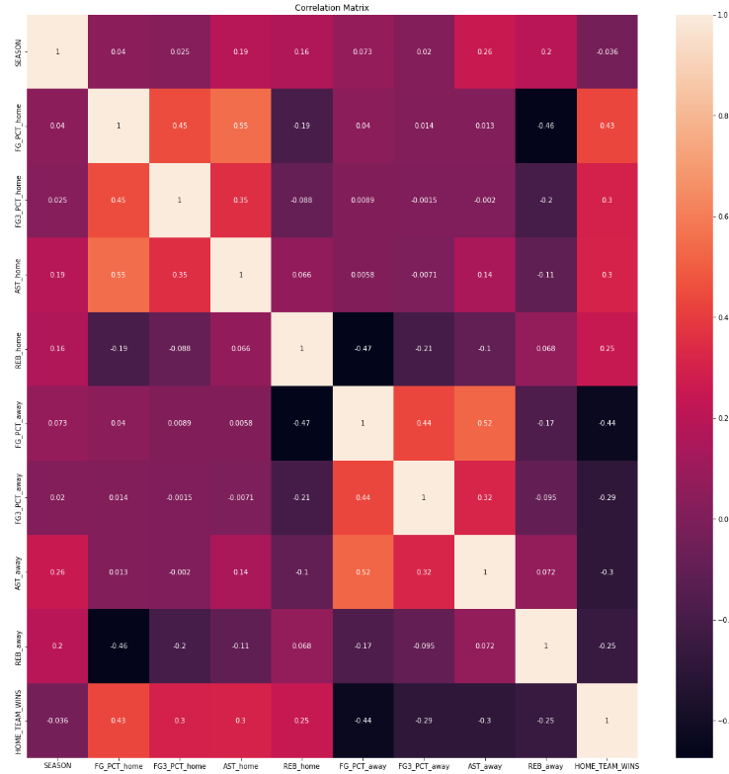
Correlation Matrix
PTS_home
FG_PCT_home
FG3_PCT_home
AST_home
Positive correlation
2
Exploratory Data Analysis
PTS_away
FG_PCT_away
FG3_PCT_away
AST_away.
Negative Correlation
Free Throws are not correlated

Slide 8
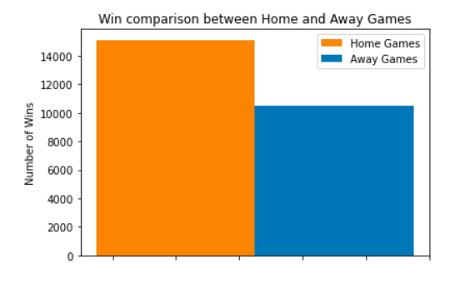
Home is a Big Advantage
2
Exploratory Data Analysis

Slide 9
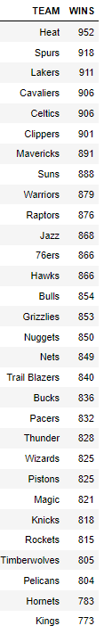
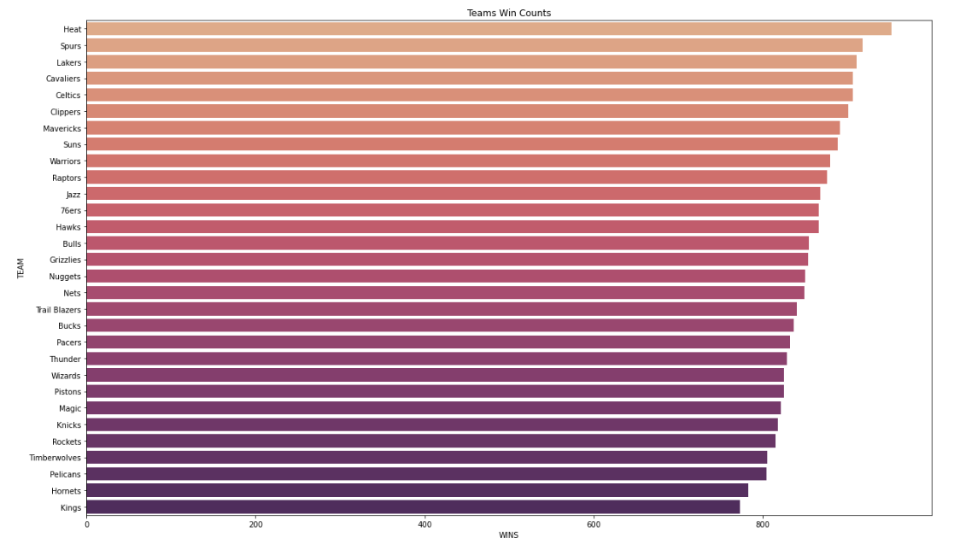
Strongest Teams
2
Exploratory Data Analysis

Slide 10
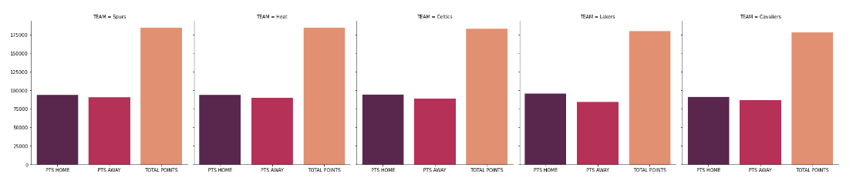
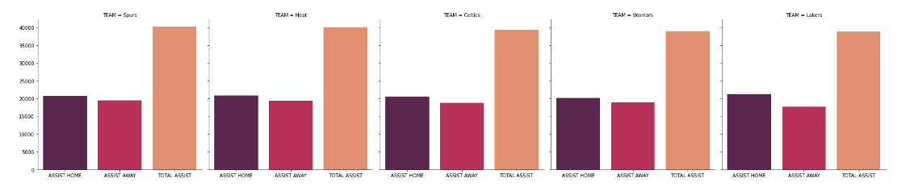
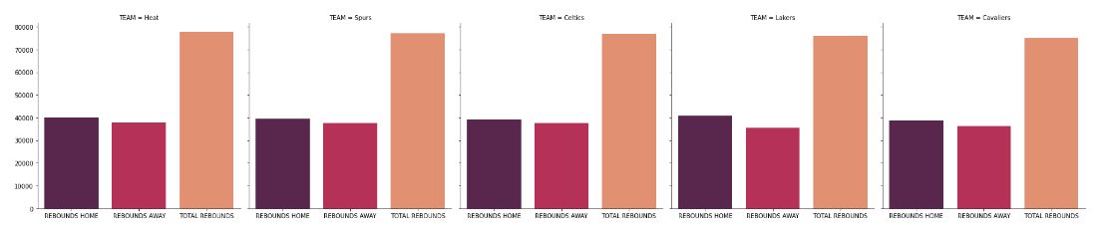
Strongest Teams
2
Points
Exploratory Data Analysis
Assist
Rebounds

Slide 11
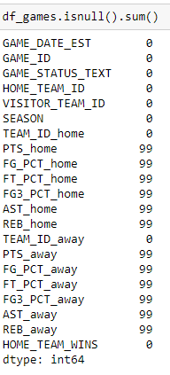
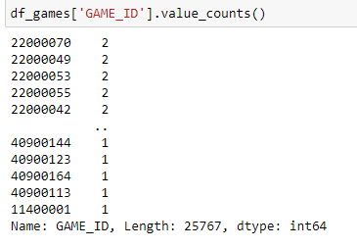
Feature Engineering
3
29 Duplicate droped
99 NaN Droped
Feature Engineering

Slide 12
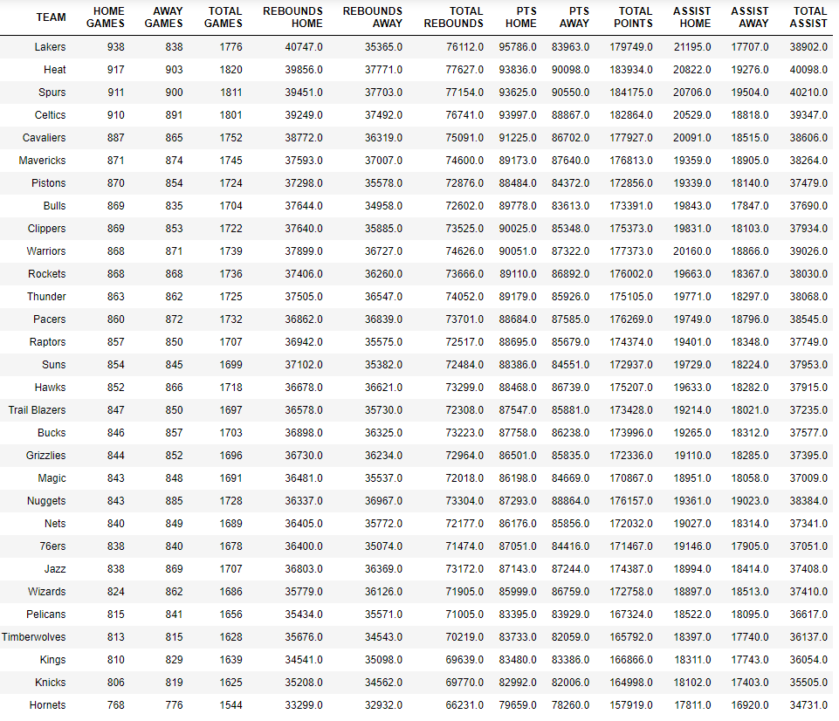
Feature Engineering
Classification of Teams
3
Feature Engineering

Slide 13
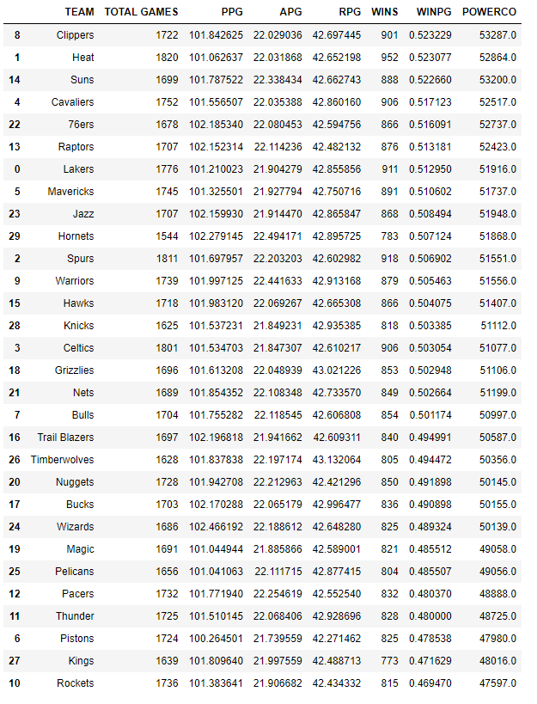
Feature Engineering
3
PPG, APG, RPG, WINPG
Feature Engineering
POWERCO

Slide 14
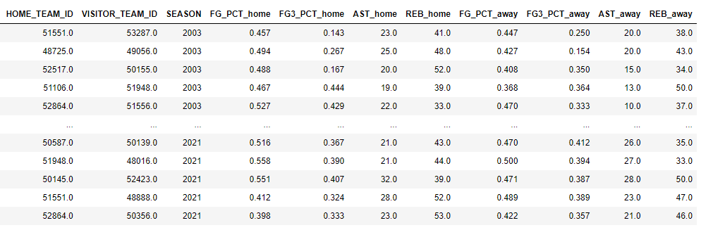
Feature Engineering
GAME ID
Points
FreeThrow Percentage
Game Date (Season stayed)
Has been droped
3
Feature Engineering

Slide 15
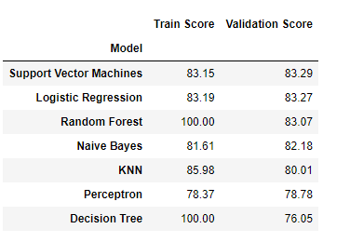
Train and Test
4
Building Models

Slide 16

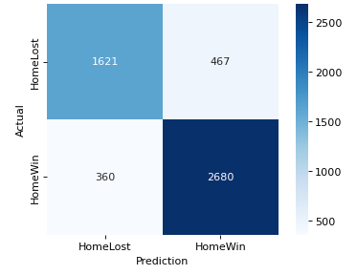
Logistic Regression
4
Cross Validation
Confusion Matrix
Building Models

Slide 17
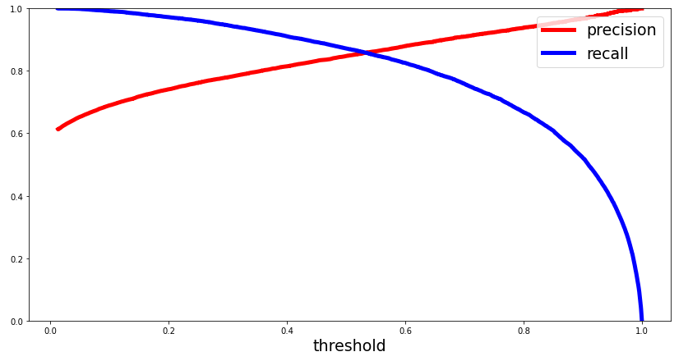
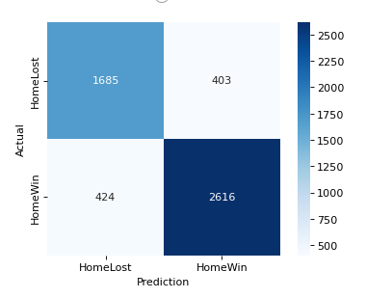
Roc Curve
5
Metrics about Model Performance

Slide 18
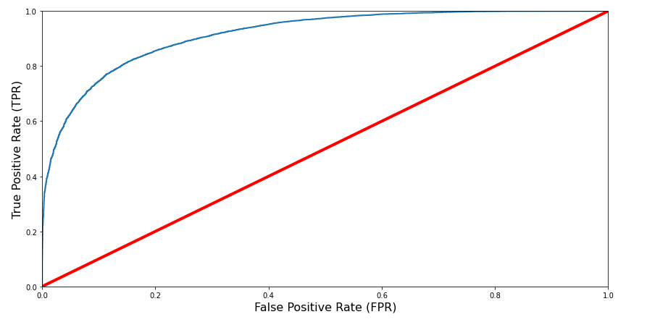
False Positive Rates
5
Metrics about Model Performance

Slide 19
Summary &Challenges
Building a succesfull model vs User Friendly model
Basketball is a team-spirited sport so prediction variables are changeable
More variables can be included

Slide 20
Teşekkürler
Aydın Kofteci
akofteci@gmail.com

